Slide 1
C66x Code Optimization

Slide 2
Disclaimer
This presentation DOES NOT address multicore optimization.
Multicore optimization issues are covered in the multicore considerations presentation.
This is NOT a comprehensive collection of optimization techniques.
For a more thorough examination of optimization, please consider the C6000 Embedded Design Workshop.

Slide 3
Agenda
Hardware and Software Pipeline
Basic Optimization
Achieving Optimized Software Pipeline
Dependencies
Overhead
SIMD and Registers Pressure
IF Statements and Inline
Cache Optimization
L1P and L1 D Optimization
Benchmark

Slide 4
Hardware and Software Pipeline
Hardware and Software Pipeline
Basic Optimization
Achieving Optimized Software Pipeline
Dependencies
Overhead
SIMD and Registers Pressure
IF Statements and Inline
Cache Optimization
L1P and L1 D Optimization
Benchmark

Slide 5
Non-Pipelined vs. Pipelined CPU
Clock Cycles
CPU Type
1 2 3 4 5 6 7 8 9
Non-Pipelined
F₁ D₁ E₁
F₂ D₂ E₂
F₃ D₃ E₃
Pipelined
F₁ D₁ E₁
F₂ D₂ E₂
F₃ D₃ E₃
Stage | Pipeline Function
F Fetch | Generate program fetch address Read opcode
D Decode | Route opcode to functional units Decode instructions
E Execute | Execute instructions
Pipeline full
Now look at the C66x pipeline.

Slide 6
Program Fetch Phases
Phase | Description
PG | Generate fetch address
PS | Send address to memory
PW | Wait for data ready
PR | Read opcode
C66x Core
Functional
Units
PR
Memory
PG
PS
PW

Slide 7
Pipeline Phases - Review
Program Fetch
Decode
Execute
PG PS PW PR D E
PG PS PW PR D E
PG PS PW PR D E
PG PS PW PR D E
PG PS PW PR D E
PG PS PW PR D E
Single-cycle performance is not affected by adding three program fetch phases.
That is, there is still an execute every cycle.
How about decode? Is it only one cycle?

Slide 8
Decode Phases
Decode Phase | Description
DP | Intelligently routes instruction to functional unit (dispatch)
DC | Instruction decoded at functional unit (decode)
C66x Core
Functional
Units
PR
DP
DC
Memory
PG
PS
PW

Slide 9
Pipeline Phases
Program Fetch
Decode
Execute
PG PS PW PR DP DC E1
PG PS PW PR DP DC E1
PG PS PW PR DP DC E1
PG PS PW PR DP DC E1
PG PS PW PR DP DC E1
PG PS PW PR DP DC E1
PG PS PW PR DP DC E1
Pipeline Full
How many cycles does it take to execute an instruction?
Notes:
Should the EXECUTEs be sequential here? E1, E2. E3, etc.

Slide 10
Instruction Delays
All C66x instructions require only one cycle to execute, but some results are delayed.
Description | Instruction Example | Delay
Single Cycle | All instructions except | 0
Integer multiplication and new floating point | MPY, FMPYSP | 1
Legacy floating point multiplication | MPYSP | 2
Load | LDW | 4
Branch | B | 5

Slide 11
C66x DSP VLIW Architecture
Two (almost independent) sides, A and B
8 functional units, M, L, S, D
Up to 8 instructions sustained dispatch rate
Memory
A0
.D1
.D2
B0
.S1
.S2
MACs
.M1
.M2
. .
.
.L1
.L2
. .
.
A31
B31
Controller/Decoder

Slide 12
Software Pipeline Example
Dot product; A typical DSP MAC operation.
LDH
|| LDH
MPY
ADD
How many cycles would it take to perform this loop five times?
(Disregard delay slots)
5 x 3 = 15 cycles

Slide 13
Non-Pipelined Code
Cycle
1
.D1
ldh
.D2
ldh
.M1
.M2
.L1
.L2
.S1
.S2
2
mpy
3
add
4
ldh
ldh
5
mpy
6
add
7
ldh
ldh
8
mpy
9
add
Notes:
Indicate here how many cycles this code processing will require (15 cycles)

Slide 14
Pipelining Code
Cycle
1
.D1
ldh
.D2
ldh
.M1
.M2
.L1
.L2
.S1
.S2
2
ldh
ldh
mpy
3
ldh
ldh
mpy
add
4
ldh
ldh
mpy
add
5
ldh
ldh
mpy
add
6
No LDHs?
mpy
add
7
add
Pipelining these instructions took 1/2 the cycles!

Slide 15
Software Pipeline Support
The compiler is smart enough to schedule instructions efficiently.
Software pipeline is the major speed-up mechanism for VLIW architecture.
Software pipeline requires deterministic execution:
Not if, branch, and call
No interrupts
Dependencies
The C66x hardware SPLOOP enables servicing of interrupts in the middle of loops.

Slide 16
What is SPLOOP?
SPLOOP is an instruction buffer with a set of control hardware registers that keep track of the loop iterations:
Iteration refers to a complete algorithm processing of one element of the vector.
When software pipeline is used, a loop processes multiple iterations.
SPLOOP keeps track of what iterations are currently in the process.
When an interrupt occurs:
SPLOOP stops processing new iterations
But finishes all iterations already in the pipeline
Then serves the interrupt
Upon returning from the ISR, SPLOOP starts processing the next iteration and refills the pipeline.

Slide 17
SPLOOP: Advantages & Limitations
SPLOOP Advantages:
Enables interrupts during software pipeline
Saves memory
Saves power
Implicit loop counter saves a unit
E2E example of 32 MAC per cycle
Nested loops are supported
Scheduled by the compiler
SPLOOP Limitations
Limits number of executable packets (14)
Limits on the usage and location of some instructions (see the documentations)
NOTE: The compiler is not always smart enough to schedule SPLOOP, especially if the minimum number of iterations is not known (to the compiler).

Slide 18
Basic Optimization
Hardware and Software Pipeline
Basic Optimization
Achieving Optimized Software Pipeline
Dependencies
Overhead
SIMD and Registers Pressure
IF Statements and Inline
Cache Optimization
L1P and L1 D Optimization
Benchmark

Slide 19
Generic Optimization Advice
Never have printf in your code!
Use peripherals (and coprocessors) to offload unnecessary tasks from the CorePacs.
Make sure the loop trip counters are (unsigned) int or long (32 bit) … and not short (16 bit).

Slide 20
Code Development
Code Generation Tools can build executables from different code types:
Generic C or C++ code
C with intrinsic
Linear Assembly
Assembly (DETAI)
Optimization is performed:
In the front end
Using the intrinsic
Resource allocation and software pipeline search in optimized linear assembly
To understand the quality of the optimization of a loop, compare the theoretical iteration interval (II: The actual number of cycles between two results of the loop) to the result of the assembler/optimizer.
Was the software pipeline successful (if not, why)?
Is the usage balanced between the two sides (if not, can it be improved)?
What are the bottlenecks and how to mitigate them?
To keep the assembly file, set the –k option NOTE: Screen shots in the following examples are taken from CCS 5.3.0.

Slide 21
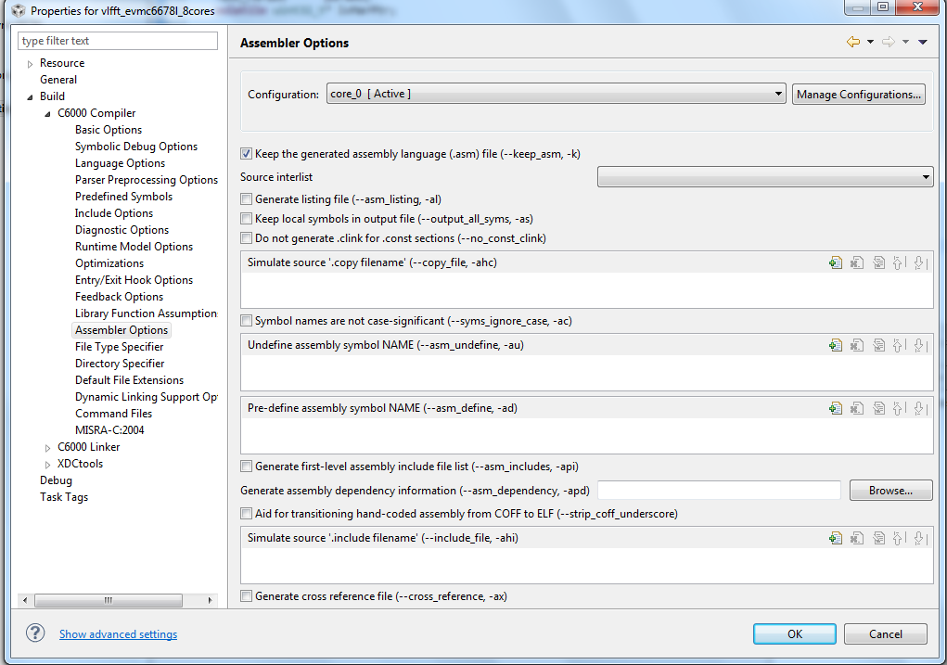
Assembler Options

Slide 22
Software Pipeline Example
;*----------------------------------------------------------------------------*
;* SOFTWARE PIPELINE INFORMATION
;*
;* Loop source line : 64
;* Loop opening brace source line : 65
;* Loop closing brace source line : 65
;* Known Minimum Trip Count : 1
;* Known Max Trip Count Factor : 1
;* Loop Carried Dependency Bound(^) : 13
;* Unpartitioned Resource Bound : 2
;* Partitioned Resource Bound(*) : 4
;* Resource Partition:
;* A-side B-side
;* .L units 0 0
;* .S units 0 0
;* .D units 0 4*
;* .M units 0 1
;* .X cross paths 0 0
;* .T address paths 0 4*
;* Long read paths 0 0
;* Long write paths 0 0
;* Logical ops (.LS) 0 1 (.L or .S unit)
;* Addition ops (.LSD) 0 0 (.L or .S or .D unit)
;* Bound(.L .S .LS) 0 1
;* Bound(.L .S .D .LS .LSD) 0 2
;*
;* Searching for software pipeline schedule at ...
;* ii = 13 Schedule found with 2 iterations in parallel
;* Done
;*
;* Loop will be splooped
;* Collapsed epilog stages : 0
;* Collapsed prolog stages : 0
;* Minimum required memory pad : 0 bytes
;*
;* Minimum safe trip count : 1
;*----------------------------------------------------------------------------*
$

Slide 23
SPLOOP Instructions from Compiler
$C$L3: ; PIPED LOOP PROLOG
SPLOOPD 13 ;26 ; (P)
|| ADD .D2 SP,16,B5
|| MV .L2X A10,B8
|| ADD .L1 A15,A3,A3
|| MVC .S2 B4,ILC
;** --------------------------------------------------------------------------*
$C$L4: ; PIPED LOOP KERNEL
LDW .D2T2 *B8,B4 ; |65| (P) <0,0>
SPMASK L2,D2
|| ADD .D2 SP,16,B5
|| ADD .L2X B5,A3,B7
SPMASK L2
|| MV .L2X A12,B6
|| LDW .D2T2 *B7++(16),B9 ; |65| (P) <0,2> ^

Slide 24
Build Options for Optimization
Always compile with –s and –mw, as they extra information to the resulting assembly file
-s shows source code after high-level optimization
-mw provides extra information on software pipelined loops
Safe for production code; No performance impact

Slide 25
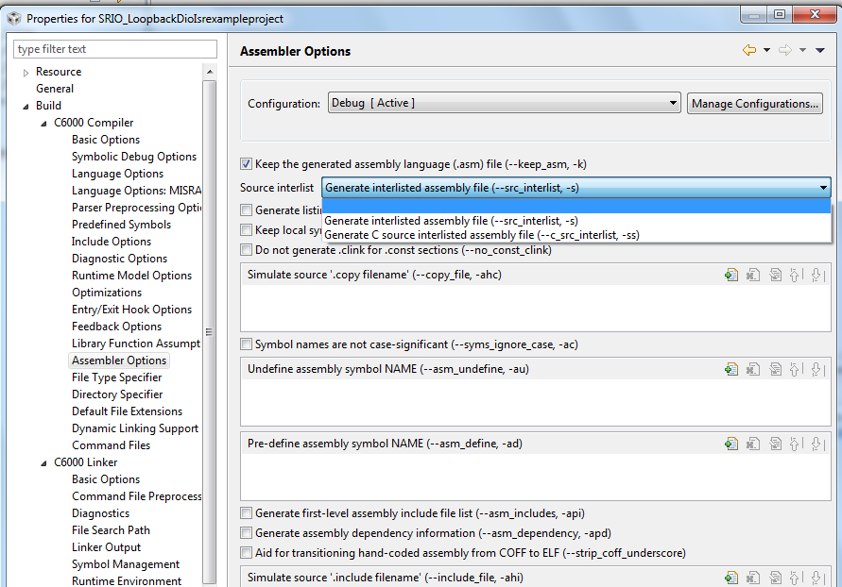
-S and -MW Setting

Slide 26
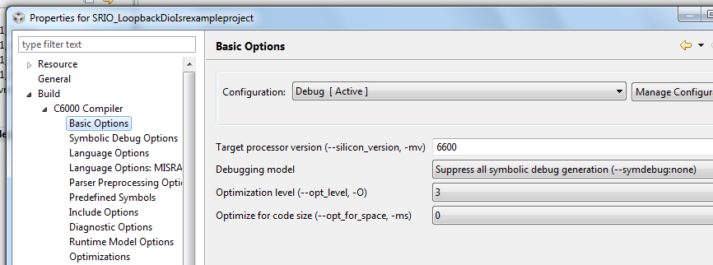
Build Options for Optimization(2)
Select the “best” build options.
More than just “turn on –o3”!
DO NOT use –g

Slide 27
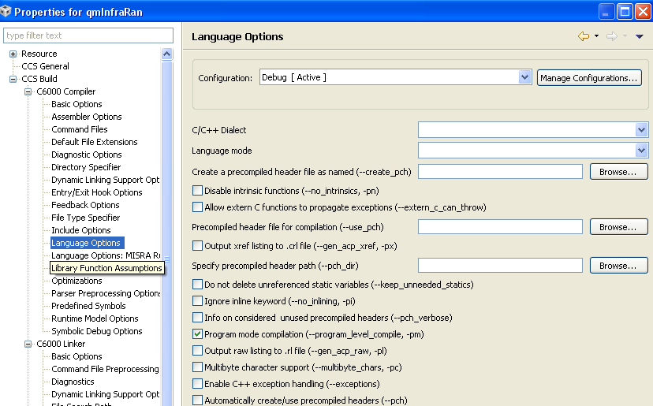
Global Optimization Across Files
-pm = Program Mode Compilation

Slide 28
Choosing the “Right” Build Options
–mv6600 enables 6600 ISA
–o[2|3] = Optimization level. Critical!
–o2/-o3 enables SPLOOP (c66 hardware loop buffer).
–o3, file-level optimization is performed.
–o2, function-level optimization is performed.
–o1, high-level optimization is minimal
–ms[0-3] is used if codesize is a concern:
Use in conjunction with –o2 or –o3.
Try –ms0 or –ms1 with performance critical code.
Consider –ms2 or –ms3 for seldom executed code.
NOTE: Improved codesize may mean better cache performance.
–mi[N]
–mi100 tells the compiler it cannot generate code that turns interrupts off for more than (approximately) 100 cycles.
For loops that do not SPLOOP, choose ‘balanced’ N (i.e., large enough to get best performance, small enough to keep system latency low).

Slide 29
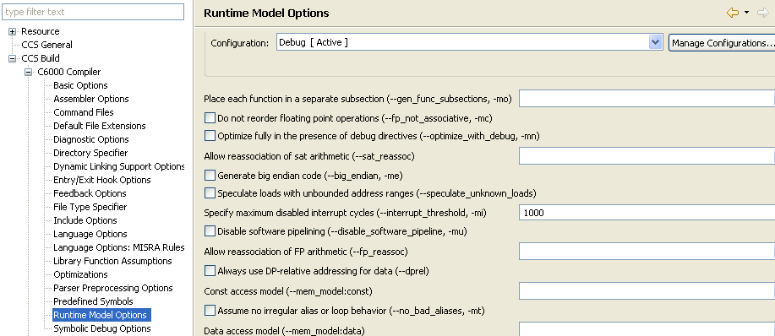
Compiler Interrupt Threshold (-mi)
–mi tells the compiler what cycle period is required between interrupts: -mi <threshold>
If the interrupt threshold number will not be exceeded within a loop, the compiler may disable interrupts and use multiple assignments to a reg.
If compiler cannot determine loop count, it assumes the threshold is exceeded and generates an interruptible loop (albeit, maybe a slower loop).
To control this on a function (vs. project) level, use: #pragma FUNC_INTERRUPT_THRESHOLD(func, threshold);

Slide 30
Build Options to Avoid
–g generates full symbolic debug. While it is great for debugging, it should not be used in production code.
Inhibits code reordering across source line boundaries
Limits optimizations around function boundaries
Can cause a 30-50% performance degradation for control code
Basic function-level profiling support now provided by default
–ss generates interlist source code into assembly file.
As with –g, this option can negatively impact performance.

Slide 31
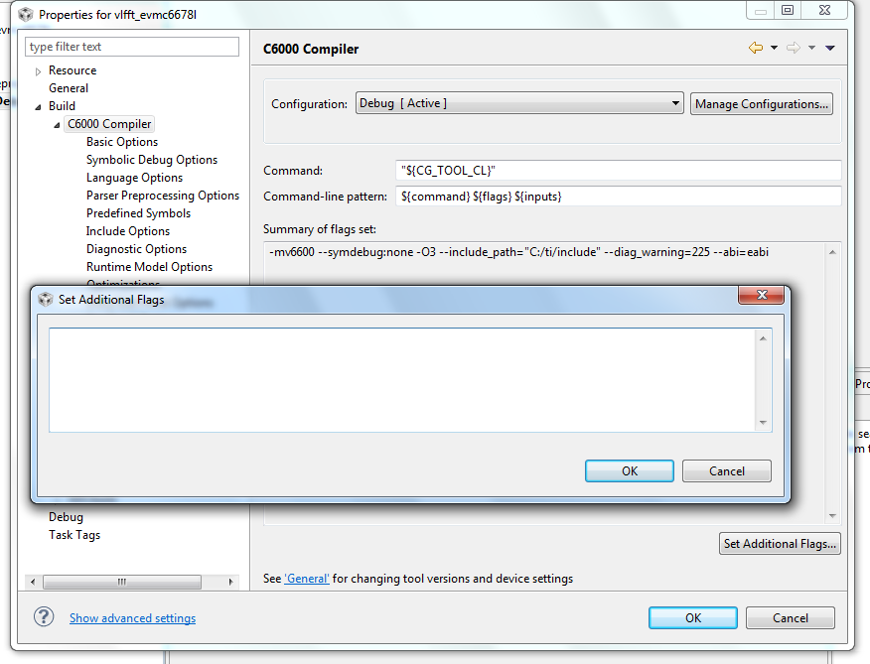
And if You Don’t Find the GUI?

Slide 32
Outline
Hardware and Software Pipeline
Basic Optimization
Achieving Optimized Software Pipeline
Dependencies
Overhead
SIMD and Registers Pressure
IF Statements and Inline
Cache Optimization
L1P and L1 D Optimization
Benchmark

Slide 33
Golden Rule of Software Pipeline
The larger the loop,
the less efficient the optimizer.
If your application code contains very long loops … break the loop into multiple loops … even if it means storing intermediate results in L1

Slide 34
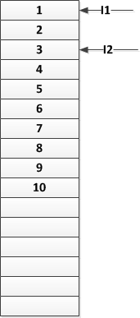
Loop Dependency (1)
The compiler motto: Safety before optimization!
If the compiler is not sure, it will always choose the safe option.
A typical case:
Solution: Tell the compiler that *i1 and *i2 do not point to the same area.
void simpleCopyFunction(int *i1, out *i2, int N)
{
int x ,i ;
for (i=0; i<N;i++)
{
x = *i1++ ;
*i2++ = 5*x ;
}
}

Slide 35
Restrict Qualifiers Enables Software Pipeline
original loop
restrict qualified loop
execution time
iter i
iter i
ii
i+1
load
compute
store
load
compute
store
i+2
ii
load
compute
store
load
compute
store
i+1
load
compute
store
i+2
load
compute
store

Slide 36
Restrict Qualifiers
Loop iterations cannot be overlapped unless input and output are independent (do not reference the same memory locations).
Most users write their loops so that loads and stores do not overlap.
Compiler does not know this unless the compiler sees all callers or user tells compiler.
Use restrict qualifiers to notify compiler.
Restrict tells the compiler that any location addressed by the following pointer WILL NOT be accessed by any other vector.
myfunc(type1 input[ ],
type2 *output)
{
for (…)
{
load from input
compute
store to output
}
}
myfunc(type1 input[restrict],
type2 *restrict output)

Slide 37
Restrict Qualifying Pointers in Structures
In the past, pointers that are structure elements cannot be directly restrict-qualified neither with –mt nor by using the restrict keyword.
NOTE: Fixed in CGT 6.1.0
Instead, create local pointers at top-level of function and restrict qualify pointers.
Use local pointers in function instead of original pointers.
Even though it has been fixed, including local pointers in the code instead of the structure is highly recommended.
myfunc(_str *s)
{
_str *t
// declare local pointers at
// top-level of function
int * restrict p
int * restrict v
…
// assign to sp and tp
p = s->q->p
v = t->u->v
// use sp and tp instead
// of s->q->p and t->u->v
*p = …
*v = …
= *p
= *v
}
Notes:
Restrict qualifiers may be ignored if they do not have function-level scope.

Slide 38
The Global -mt Compiler Option
–mt. Assume no pointer-based parameter writes to a memory location that is read by any other pointer-based parameter to the same function.
Generally safe except for in place transforms
Consider the following example function:
–mt is safe when memory ranges pointed to by “input” and “output” don’t overlap.
limitations of –mt: applies only to pointer-based function parameters. It says nothing about:
Relationship between parameters and other pointers (for example, “myglobal” and “output”)
Non-parameter pointers used in the function
Pointers that are members of structures, even when the structures are parameters
Pointers de-referenced via multiple levels of indirection
NOTE: -mt is not a substitute for restrict-qualifiers, which are key to achieving good performance.
selective_copy(int *input, int *output, int n)
{
int i;
for (i=0; i<n; i++)
if (myglobal[i]) output[i] = input[i];
}

Slide 39
Example: Restrict (and Structures)
myfunc(_str *restrict s)
{
int i;
#pragma MUST_ITERATE(2,,2);
for (i=0; i<s->data->sz; i++)
s->data->q[i] = s->data->p[i];
}
Restrict does not help! Only applies to s, not to s→ data→ p or s→ data→ q
-mt does not help! Only applies to s, not to s→data→p or
s→data→q
cl6x –o –mw –s –mt –mv6600
Extracted from .asm file:
;** - g2:
;** - *(i*4+(*V$0).q) = *(i*4+(*V$0).p);
;** - if ( (*V$0).sz > (++i) ) goto g2;
…
;*-------------------------------------------
;* SOFTWARE PIPELINE INFORMATION
;*
;* Loop source line : 17
;* Loop opening brace source line : 18
;* Loop closing brace source line : 18
;* Known Minimum Trip Count : 2
;* Known Max Trip Count Factor : 2
;* Loop Carried Dependency Bound(^) : 11
…
;* ii = 12 Schedule found with 2 iterat…
Note: Addresses of p, q, and sz are calculated during every loop iteration.
Bottom line: 12 cycles/result, 72 bytes

Slide 40
Example: Restrict (continued)
myfunc(_str *s)
{
int *restrict p, *restrict q;
int sz;
int i;
...
p = s->data->p;
q = s->data->q;
sz = s->data->sz;
#pragma MUST_ITERATE(2,,2);
for (i=0; i < sz; i++)
q[i] = p[i];
}
Hand-optimized source file
cl6x –o –s –mw –mv6600
Extracted from .asm file:
;** - // LOOP BELOW UNROLLED BY FACTOR(2)
…
;** - g2:
;** - _memd8((void *)U$17) =
_memd8((void *)U$14);
;** - U$14 += 2;
;** - U$17 += 2;
;** - if ( L$1 = L$1-1) ) goto g2;
…
;*-------------------------------------------
;* SOFTWARE PIPELINE INFORMATION
;*
…
;* Loop Unroll Multiple : 2x
;* Known Minimum Trip Count : 1
;* Known Max Trip Count Factor : 1
;* Loop Carried Dependency Bound(^) : 0
…
;* ii = 2 Schedule found with 3 iterati…
Observe: Now the compiler automatically unrolls loop and SIMDs memory accesses.
Bottom line:
1 cycle/result, 44 bytes

Slide 41
The –mh Compiler Option
–mh<num>. Speculative loads. Permits compiler to fetch (but not store) array elements beyond either end of an array by <num> bytes. Can lead to:
Better performance, especially for “while” loops
Smaller code size for both “while” loops and “for” loops
Not needed if SPLOOP is used
Software-pipelined loop information in the compiler-generated assembly file suggests the value of <num>
Indicates compiler is fetching 0 bytes beyond the end of an array.
If loop is rebuilt with –mh56 (or greater), there may be better performance and/or smaller code size.
NOTE: Need to pad buffer of <num> bytes on both ends of sections that contain array data
Alternatively, other memory areas (code or independent data) can be used as pad regions.
;* Minimum required memory pad : 0 bytes
;*
;* For further improvement on this loop, try option -mh56
MEMORY {
/* pad (reserved): origin = 1000, length = 56 */
myregion: origin = 1056, length = 3888
/* pad (reserved): origin = 3944, length = 56 */
}

Slide 42
Outline
Hardware and Software Pipeline
Basic Optimization
Achieving Optimized Software Pipeline
Dependencies
Overhead
SIMD and Registers Pressure
IF Statements and Inline
Cache Optimization
L1P and L1 D Optimization
Benchmark

Slide 43
Reducing Loop Overhead
If the compiler does not know that a loop will execute at least once, it will need to:
Insert code to check if the trip count is <= zero
Conditionally branch around the loop
This adds overhead to loops.
If the loop is guaranteed to execute at least once, insert pragma immediately before loop to notify the compiler:
#pragma MUST_ITERATE(1,,);
or, more generally
#pragma MUST_ITERATE(min, max, mult);
myfunc:
compute trip count
if (trip count <= 0)
branch to postloop
for (…)
{
load input
compute
store output
}
postloop:
If trip count is not known to be less than zero, compiler inserts code shown in yellow.

Slide 44
Detecting Loop Overhead
myfunc.c:
myfunc(int *input1, int *input2, int *output, int n)
{
int i;
for (i=0; i<n; i++)
output[i] = input1[i] - input2[i];
}
Extracted from myfunc.asm (generated using –o –mv6600 –s –mw):
;** 4 ----------------------- if ( n <= 0 ) goto g4;
;** ----------------------- U$11 = input1;
;** ----------------------- U$13 = input2;
;** ----------------------- U$16 = output;
;** ----------------------- L$1 = n;
;** ----------------------- #pragma MUST_ITERATE(1,…)
;** -----------------------g3:
;** 5 ----------------------- *U$16++ = *U$11++-*U$13++;
;** 4 ----------------------- if ( --L$1 ) goto g3;
;** -----------------------g4:
Notes:
Pragma in optimizer comments is *inside* if statement.
Does not imply that original loop executes at least once.
All examples in this presentation were generated using CCS 3.2 (cgt version 6.0.1).

Slide 45
Example: MUST_ITERATE, nassert, and SIMD
myfunc(int * restrict input1,
int * restrict input2,
int * restrict output,
int n)
{
int i;
#pragma MUST_ITERATE(1,,);
for (i=0; i < n; i++)
output[i] =
input1[i] – input2[i];
}
cl6x –o –s –mw –mv6600
-mw comments (from .asm file):
;*-------------------------------------------
;* SOFTWARE PIPELINE INFORMATION
;*
;* Known Max Trip Count Factor : 1
;* Loop Carried Dependency Bound(^) : 0
;* Unpartitioned Resource Bound : 2
;* Partitioned Resource Bound(*) : 2
;* Resource Partition:
;* A-side B-side
;* .D units 2* 1
;* .T address paths 2* 1
;*
;* ii = 2 Schedule found with 4 iter...
;*
;* SINGLE SCHEDULED ITERATION
;*
;* $C$C24:
;* 0 LDW .D1T1 *A5++,A4
;* 1 LDW .D2T2 *B4++,B5
;* 2 NOP 4
;* 6 SUB .L1X B5,A4,A3
;* 7 STW .D1T1 A3,*A6++
;* || SPBR $C$C24
;* 8 ; BRANCHCC OCCURS {$C$C24}
2 cycles / result
resources unbalanced
-s comments (from .asm file):
;** - U$12 = input1;
;** - U$14 = input2;
;** - U$17 = output;
;** - L$1 = n;
…
;** - g2:
;** - *U$17++ = *U$12++ - *U$14++;
;** - if ( --L$1 ) goto g2;

Slide 46
Example: MUST_ITERATE, nassert and SIMD (cont)
Suppose we know that the trip count is a multiple of 4…
myfunc(int * restrict input1,
int * restrict input2,
int * restrict output,
int n)
{
int i;
#pragma MUST_ITERATE(1,,4);
for (i=0; i < n; i++)
output[i] = input1[i] – input2[i];
}

Slide 47
Example: MUST_ITERATE, nassert and SIMD (cont)
cl6x –o –s –mw –mv6600
-mw comments (from .asm file):
-s comments (from .asm file):
;* SOFTWARE PIPELINE INFORMATION
;*
;* Loop Unroll Multiple : 2x
;* Loop Carried Dependency Bound(^) : 0
;* Unpartitioned Resource Bound : 3
;* Partitioned Resource Bound(*) : 3
;* Resource Partition:
;* A-side B-side
;* .D units 3* 2
;* .T address paths 3* 3*
;*
;* ii = 3 Schedule found with 3 iter...
;*
;* SINGLE SCHEDULED ITERATION
;* $C$C24:
;* 0 LDW .D1T1 *A6++(8),A3
;* || LDW .D2T2 *B6++(8),B4
;* 1 LDW .D1T1 *A8++(8),A3
;* || LDW .D2T2 *B5++(8),B4
;* 2 NOP 3
;* 5 SUB .L1X B4,A3,A4
;* 6 NOP 1
;* 7 SUB .L1X B4,A3,A5
;* 8 STNDW .D1T1 A5:A4,*A7++(8)
;** // LOOP BELOW UNROLLED BY FACTOR(2)
;** U$12 = input1;
;** U$14 = input2;
;** U$23 = output;
;** L$1 = n >> 1;
…
;** g2:
;** _memd8((void *)U$23) =
_itod(*U$12[1]-*U$14[1],*U$12-*U$14);
;** U$12 += 2;
;** U$14 += 2;
;** U$23 += 2;
;** if ( --L$1 ) goto g2;
1.5 cycles / result
(resource balance better but not great)

Slide 48
Example: MUST_ITERATE, _nassert, SIMD (cont)
Suppose we tell the compiler that input1, input2 ,and output are aligned on double-word boundaries…
* Note – must _nassert(x) before x is used
myfunc(int * restrict input1,
int * restrict input2,
int * restrict output,
int n)
{
int i;
_nassert((int) input1 % 8 == 0);
_nassert((int) input2 % 8 == 0);
_nassert((int) output % 8 == 0);
#pragma MUST_ITERATE(1,,4);
for (i=0; i < n; i++)
output[i] = input1[i] – input2[i];
}

Slide 49
Example: MUST_ITERATE, nassert and SIMD (cont)
myfunc(int * restrict input1,
int * restrict input2,
int * restrict output,
int n)
{
int i;
#pragma MUST_ITERATE(1,,4);
for (i=0; i < n; i++)
output[i] =
input1[i] – input2[i];
}
-mw comments (from .asm file):
cl6x –o –s –mw –mv64+
;* SOFTWARE PIPELINE INFORMATION
;*
;* Loop Unroll Multiple : 4x
;* Loop Carried Dependency Bound(^) : 0
;* Unpartitioned Resource Bound : 3
;* Partitioned Resource Bound(*) : 3
;* Resource Partition:
;* A-side B-side
;* .D units 3* 3*
;* .T address paths 3* 3*
;*
;* ii = 3 Schedule found with 3 iter...
;*
;* SINGLE SCHEDULED ITERATION
;* $C$C24:
;* 0 LDDW .D2T2 *B18++(16,B9:B8
;* || LDDW .D1T1 *A9++(16),A7:A6
;* 1 LDDW .D1T1 *A3++(16),A5:A4
;* || LDDW .D2T2 *B5++(16),B17:B16
;* 2 NOP 3
;* 5 SUB .L2X A7,B9,B7
;* 6 SUB .L2X A6,B8,B6
;* || SUB .L1X B16,A4,A4
;* 7 SUB .L1X B17,A5,A5
;* 8 STDW .D2T2 B7:B6,*B4++(16)
;* || STDW .D1T1 A5:A4,*A8++(16)
-s comments (from .asm file):
;** // LOOP BELOW UNROLLED BY FACTOR(4)
;** U$12 = (double * restrict)input1;
;** U$16 = (double * restrict)input2;
;** U$27 = (double * restrict)output;
;** L$1 = n >> 2;
…
;** g2:
;** C$5 = *U$16;
;** C$4 = *U$12;
;** *U$27 = _itod((int)_hi(C$4)-
(int)_hi(C$5),
(int)_lo(C$4)-
(int)_lo(C$5));
;** C$3 = *U$16[1];
;** C$2 = *U$12[1];
;** *U$27 = _itod((int)_hi(C$2)-
(int)_hi(C$3),
(int)_lo(C$2)-
(int)_lo(C$3));
;** U$12 += 2;
;** U$16 += 2;
;** U$27 += 2;
;** if ( --L$1) ) goto g2;
0.75 cycles / result
(resources balanced)

Slide 50
Outline
Hardware and Software Pipeline
Basic Optimization
Achieving Optimized Software Pipeline
Dependencies
Overhead
SIMD and Registers Pressure
IF Statements and Inline
Cache Optimization
L1P and L1 D Optimization
Benchmark

Slide 51
SIMD and Registers
If the resources are not balanced, unrolling the loop pragma may help
#pragma UNROLL(N) force the compiler to unroll the loop
Be aware of the following:
SPLOOP limitation
Registers pressure
Using SIMD intrinsics can speed up the loop.
Be aware of registers pressure (need to wait in the pipeline until a register is available).

Slide 52
Using (more) SIMD
Leverage new C66x intrinsics:
_dadd2 - Four-way SIMD addition of signed 16-bit values producing four signed 32-bit results.
_ddotp4h - Performs two dot-products between four sets of packed 16-bit values.
_qmpy32 - Four-way SIMD multiply of signed 32-bit values producing four 32-bit results.

Slide 53
Outline
Hardware and Software Pipeline
Basic Optimization
Achieving Optimized Software Pipeline
Dependencies
Overhead
SIMD and Registers Pressure
IF Statements and Inline
Cache Optimization
L1P and L1 D Optimization
Benchmark

Slide 54
If Statements
Compiler will if-convert short if statements:
Original C code: if (p) then x = 5 else x = 7
Before if conversion: [p] branch thenlabel
x = 7
goto postif
thenlabel: x = 5
postif:
After if conversion: [p] x = 5 || [!p] x = 7

Slide 55
If Statements (cont.)
Compiler will not if-convert long if statements.
Compiler will not software pipeline loops with if statements that are not if-converted.
For software “pipeline-ability,” user must transform long if statements.
;*---------------------------------------------------
;* SOFTWARE PIPELINE INFORMATION
;* Disqualified loop: Loop contains control code
;*---------------------------------------------------

Slide 56
Example of If Statement Reduction When No Else Block Exists
Original function:
largeif1(int *x, int *y)
{
for (…)
{
if (*x++)
{
i1
i2
…
*y = …
}
y++
}
}
Hand-optimized function:
largeif1(int *x, int *y)
{
for (…)
{
i1
i2
…
if (*x++)
*y = …
y++
}
}
pulled out
of if statement
Note: Only assignment to y must be guarded for correctness.
Profitability of if reduction depends on sparsely of x.

Slide 57
Or If Statement Can Be Eliminated Entirely
Original function:
large_if1(int *x, int *y)
{
for (…)
{
if (*x++)
{
i1
i2
…
*y += …
}
y++
}
}
Hand-optimized function:
large_if1(int *x, int *y)
{
for (…)
{
i1
i2
…
p = (*x++ != 0)
*y += p * (…)
y++
}
}
Sometimes this works better….

Slide 58
If Reduction Via Common Code Consolidation
Original function:
large_if2(int *x, int *y, int *z)
{
for (…)
{
if (*x++)
{
int t = *z++
*w++ = t
*y++ = t
}
else
{
int t = *z++
*y++ = t
}
}
}
Hand-optimized function:
large_if2(int *x, int *y, int *z)
{
for (…)
{
int t = *z++
if (*x++)
{
*w++ = t
}
*y++ = t
}
}
NOTE: Makes loop body smaller. Eliminates second copy of:
t = *z++
*y++ = t

Slide 59
Eliminating Nested If Statements
Compiler will software pipeline nested if statements less efficiently, if at all.
Original function:
complex_if(int *x, int *y,
int *z)
{
for (…)
{
// nested if stmt
if (*z++)
i1
else
if (*x)
*y = c
y++
x++
}
}
Hand-optimized function:
complex_if(int *x, int *y,
int *z)
{
for (…)
{
// nested if stmt removed
if (*z++)
i1
else
{
p = (*x != 0)
*y = !p * *y + p * c
}
y++
x++
}
}

Slide 60
Outline
Hardware and Software Pipeline
Basic Optimization
Achieving Optimized Software Pipeline
Dependencies
Overhead
SIMD and Registers Pressure
IF Statements and Inline
Cache Optimization
L1P and L1 D Optimization
Benchmark

Slide 61
Cache Sizes and More
Cache | Maximum Size | Line Size | Ways | Coherency | Memory Banks
L1p | 32K Bytes | 32Bytes | One | No hardware coherency | NA
L1D | 32K Bytes | 64Bytes | Two | Coherent with L2 | 8 banks, each 32 bit
L2 | 512K Bytes | 128Bytes | Four | User must maintain coherency with external world invalidate write-back write-back invalidate | 2 banks, 128 bit

Slide 62
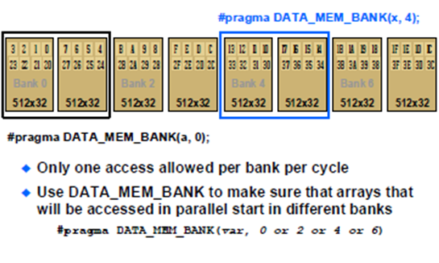
C66x L1 D Memory Banks

Slide 63
C66x L1 D Memory Banks
Bank N
512x32
11

Slide 64
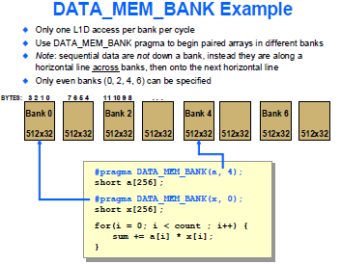
Two Loads Instruction in a Cycle

Slide 65
Memory Read Performance
 |  |  |  |  | CPU stalls
 |  |  |  |  | Single Read |  | Burst Read
 | Source | L1 cache | L2 cache | Prefetch | No victim | Victim | No victim | Victim
 | ALL | Hit | NA | NA | 0 | NA | 0 | NA
 | Local L2 RAM | Miss | NA | NA | 7 | 7 | 3.5 | 10
 | MSMC RAM (SL2) | Miss | NA | Hit | 7.5 | 7.5 | 7.4 | 11
 | MSMC RAM (SL2) | Miss | NA | Miss | 19.8 | 20.1 | 9.5 | 11.6
 | MSMC RAM (SL3) | Miss | Hit | NA | 9 | 9 | 4.5 | 4.5
 | MSMC RAM (SL3) | Miss | Miss | Hit | 10.6 | 15.6 | 9.7 | 129.6
 | MSMC RAM (SL3) | Miss | Miss | Miss | 22 | 28.1 | 11 | 129.7
 | DDR RAM (SL2) | Miss | NA | Hit | 9 | 9 | 23.2 | 59.8
 | DDR RAM (SL2) | Miss | NA | Miss | 84 | 113.6 | 41.5 | 113
 | DDR RAM (SL3) | Miss | Hit | NA | 9 | 9 | 4.5 | 4.5
 | DDR RAM (SL3) | Miss | Miss | Hit | 12.3 | 59.8 | 30.7 | 287
 | DDR RAM (SL3) | Miss | Miss | Miss | 89 | 123.8 | 43.2 | 183
SL2 – Configured as Shared Level 2 Memory (L1 cache enabled, L2 cache disabled)
SL3 – Configured as Shared Level 3 Memory (Both L1 cache and L2 cache enabled)

Slide 66
Cache Optimization – L1 P
Avoid conflict misses by ensuring that parent/child functions don’t share cache lines

Slide 67
Cache Optimization – L1 D
Similar to L1P, Avoid Conflict Misses by ensuring that functions with three pointers …
i.e., addVector (*p1_in, *p2_in, P3_out)
… don’t step on each other.
Keep cache size in mind when designing your code:
Examples:
The optimization lab
The Cholesky code

Slide 68
Cholesky Statement
If A is Hermitian and positive definite (HPD) matrix, then A can be decomposed uniquely as
A = LL*
where L is the lower triangular matrix with strictly positive diagonal entries, and L* denotes the conjugate transpose of L.

Slide 69
for (k= 1; k<N; k++)
{
for (l=0; l<2*k; l++)
{
// Values before the K point
}
for (l = k+1; l < N; l++)
{
// Value after the K point, based on values before the K point
for (m=0; m < k; m++)
{
}
}
}

Slide 70
Benchmark
Hardware and Software Pipeline
Basic Optimization
Achieving Optimized Software Pipeline
Dependencies
Overhead
SIMD and Registers Pressure
IF Statements and Inline
Cache Optimization
L1P and L1 D Optimization
Benchmark

Slide 71
Benchmarking
C66x CorePac has a 64-bit timer (Time Stamp Counter) incremented at the CPU speed.
The simplest benchmarking approach is to use lower 32 bits (TSCL), which is sufficient for most benchmarking needs.
#include <c6x.h> // bring in references to TSCL, TSCH
void main() {
...
TSCL = 0; // Initiate CPU timer by writing any val to TSCL
...
t1 = TSCL; // benchmark snapshot of free-running ctr
my_code_to_benchmark();
t2 = TSCL; // benchmark snapshot of free-running ctr
printf(“# cycles == %d\n”, (t2-t1));
}
Advantages
No need to worry about interrupts (as opposed to when reading both TSCL & TSCH)
No assembly code
No need for Chip Support Library (CSL) or other APIs
Fast

Slide 72
Benchmarking (2)
If you need more than 32 bits for benchmarking (rare) …
#include <c6x.h> // bring in references to TSCL, TSCH
#include <stdint.h> // get C99 data types such as uint64_t
uint64_t t1, t2;
t1 = _itoll(TSCH, TSCL); // get full 64-bit time snapshot
my_code_to_benchmark();
t2 = _itoll(TSCH, TSCL); // get full 64-bit time snapshot
printf(“# cycles == %lld\n”, (t2-t1));
Beware!
Not protected from interrupts between reading of TSCL and TSCH!
Fix by adding _disable_interrupts(), _restore_interrupts() intrinsics
Similar code exists in many CSL implementations
it does provide interrupt protection (via assembly code branch delay slots)

Slide 73
References
spra666, “Hand-Tuning Loops and Control Code on the TMS320C6000” [link]
spraa46, “Advanced Linker Techniques for Convenient and Efficient Memory Usage” [link]
SPRU425A, TMS320C6000 Optimizing C Compiler Tutorial
spru187, “TMS320C6000 Optimizing Compiler User’s Guide” [link]

